Slide 1



AUTONOMOUS SHIPPING Sprint 2
Jasper Vlaar, Jelte Molenaar, Job Vink, Michiel van Soest en Martin de Rijke

Slide 2
Topics
Sprint
Approach
Stakeholders
Research

Slide 3
Sprint

Slide 4

Approach
B
A

Slide 5
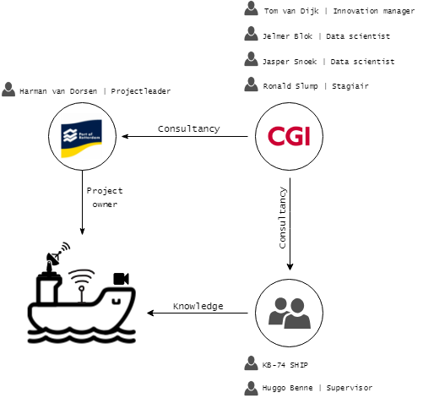
Stakeholders

Slide 6
RESEARCH
Tensorflow
Formula distance
Radar
Virtual map
Data structure
Autonomous boat

